Slide 1

School of Computing
Vel Tech Rangarajan Dr. Sagunthala R&D Institute of Science and Technology
Department of Computer Science and Engineering
10211CS224 / FULL STACK APPLICATION DEVELOPMENT (JAVA)
PROJECT REVIEW : MILESTONE PROJECT – 1
Date: 25-03-2026
Real-Time Event Synchronization Engine
SDG: SDG No – 9(Industry, Innovation and Infrastructure)
Presented By:
K.Jeeva Akash VTU24794 23UECS1079
Courses Handling Faculty:
Dr.S.Hemamalini.,M.E.,Ph.D
Assistant Professor(Senior Grade)

Slide 2
INTRODUCTION
Modern IoT environments generate continuous streams of data from multiple systems such as smart homes, industries, vehicles, and environmental sensors, but most traditional systems fail to synchronize and display this data in real-time on a unified platform.
1
When abnormal values like high temperature, pollution, overspeed, or machine vibration are not detected instantly, they can lead to safety
hazards, equipment damage, financial loss, and environmental risks.
2
This project is important because it provides a centralized real-time monitoring dashboard that ensures every event from different IoT systems is tracked, stored, and synchronized instantly.
3
4
It integrates four major IoT domains Smart Home Monitoring, Industrial Sensor Networks, Environmental Monitoring, and Vehicle Tracking into a single scalable full-stack web application.
5
Using WebSocket technology, the system delivers live updates to all connected users without requiring page refresh, ensuring sub-second
latency and seamless user experience.
6
The system intelligently classifies event severity (INFO, WARNING, ALERT, CRITICAL) based on predefined thresholds, helping users quickly identify dangerous conditions.
7
8
When critical thresholds are exceeded, automated Telegram alerts are triggered instantly, enabling rapid response and preventive action in
real-world scenarios.
9
Overall, the Real-Time Event Synchronization Engine enhances operational efficiency, improves safety monitoring, supports data-driven decision-making, and demonstrates practical full-stack IoT system implementation.

Slide 3
PROBLEM STATEMENT
In modern IoT environments, multiple systems generate large volumes of real-time data, but there is no unified platform to synchronize and monitor these events efficiently.
1
2
Existing monitoring solutions often operate independently, making it difficult to track system performance from a single dashboard.
3
Many systems lack real-time synchronization, resulting in delayed updates and slow response to critical situations.
4
Manual monitoring of sensor data increases the risk of human error and reduces operational efficiency.
5
Without automatic severity classification, identifying dangerous conditions becomes complex and time-consuming.
6
Traditional systems do not provide instant alert mechanisms for threshold violations.
7
The absence of centralized storage and analytics makes historical tracking and decision-making difficult.
8
9
Therefore, there is a need for a real-time, automated event synchronization engine that ensures instant monitoring, intelligent classification, and immediate alert notifications.

Slide 4
OBJECTIVE(S)
1
To design and develop a real-time event synchronization engine that integrates multiple IoT systems (Smart Home, Industrial, Environmental, and Vehicle Tracking) into a single unified monitoring dashboard for centralized control and visibility.
2
3
To implement WebSocket-based live data communication that ensures instant synchronization of events across all connected clients without page refresh, achieving sub-second update latency.
To develop an automated severity classification mechanism (INFO, WARNING, ALERT, CRITICAL) using predefined threshold logic to accurately identify and categorize abnormal conditions.
4
5
6
To integrate Telegram alert notifications that automatically trigger when event values exceed defined thresholds, enabling quick response and preventive action in critical situations.
7
To evaluate the performance of the system based on API response time, WebSocket delivery speed, database efficiency, and its ability to handle multiple concurrent users and high event frequency.
8
9

Slide 5
PROPOSED SYSTEM
The proposed system is a full-stack IoT monitoring platform designed to synchronize events from multiple domains into a centralized, real-time dashboard for unified monitoring and control.
1
2
It collects sensor data through REST APIs, securely stores events in a MySQL database, and instantly broadcasts
updates to all connected clients using WebSocket technology.
3
The system incorporates automated severity classification (INFO, WARNING, ALERT, CRITICAL) based on predefined threshold logic to accurately detect abnormal or risky conditions.
4
It solves the issue of delayed monitoring in traditional systems by enabling sub-second real-time updates without requiring manual page refresh or repeated data requests.
5
6
Manual supervision is minimized through automatic threshold evaluation and instant Telegram alert notifications when critical values are exceeded.
7
8
Unlike existing isolated monitoring systems, this solution integrates Smart Home, Industrial, Environmental, and Vehicle Tracking systems into a single scalable and extensible architecture.
9
The interactive dashboard provides live charts, severity statistics, recent event history, and system-wise performance metrics for improved analysis and decision-making.
Overall, the proposed system enhances operational efficiency, improves safety response time, reduces human error, and supports scalable real-time IoT data management.

Slide 6

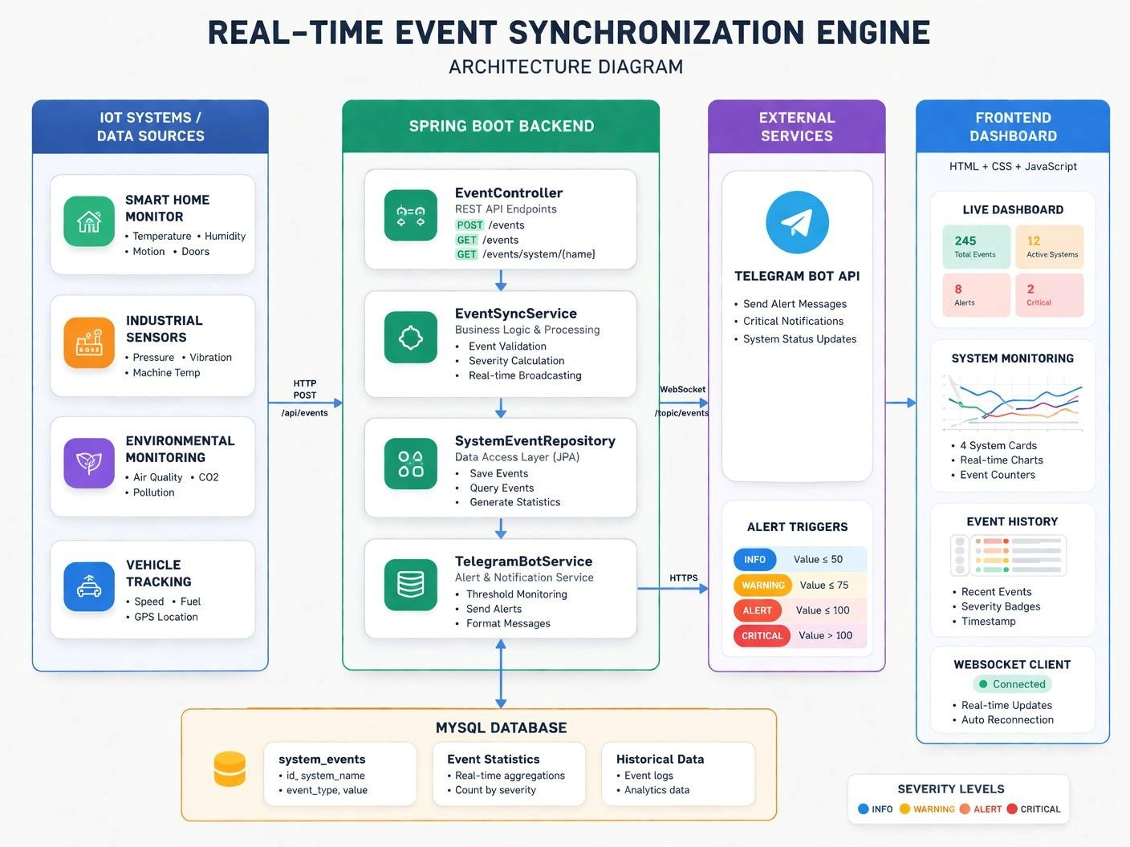
PROPOSED SYSTEM ARCHITECTURE
Input:
IoT devices send real-time sensor data (temperature, pollution, speed, etc.) through REST APIs.
Data is collected from Smart Home, Industrial, Environmental, and Vehicle systems.
Processing:
Backend processes incoming data using Spring Boot.
Severity is calculated using threshold logic (INFO, WARNING, ALERT, CRITICAL).
Business logic ensures accurate classification and validation.
1
2
3
4
5
6
Output:
Real-time dashboard updates using WebSocket (no page refresh).
Displays charts, statistics, and event logs dynamically.
Telegram alerts sent for ALERT and CRITICAL events.
7
Database:
All events are stored in MySQL database (sync_engine_db).
Maintains event history with timestamp and severity status.
8
9

Slide 7

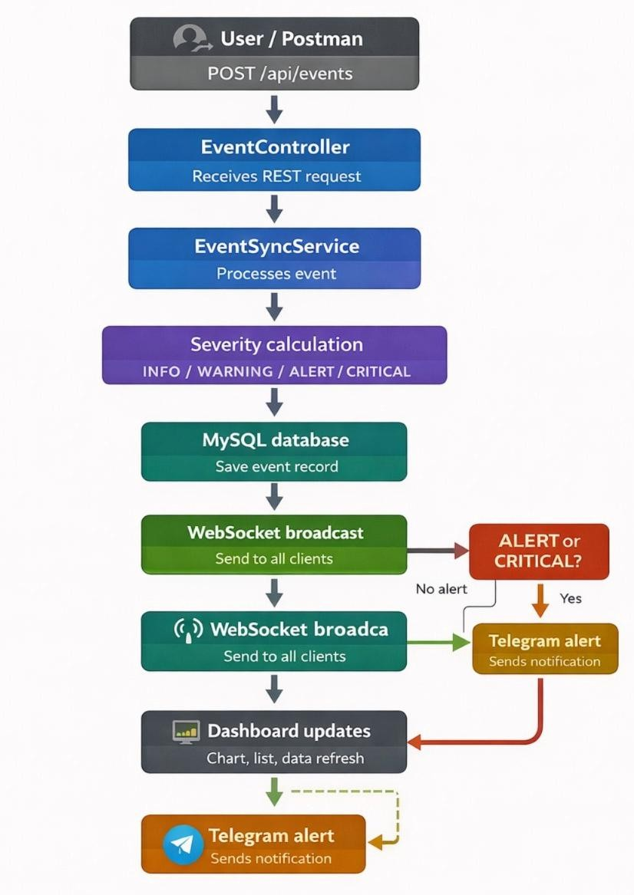
WORKFLOW
The user/device sends event data through REST API.
1
2
The system receives and processes the event in backend.
3
4
Severity level is calculated using threshold conditions.
5
Event is stored in MySQL database for tracking.
6
WebSocket sends real-time updates to dashboard.
7
8
Dashboard displays charts, statistics, and event history.
9
Telegram alert is triggered for critical conditions.

Slide 8




TECHNOLOGIES USED
1
Frontend:
2
3
HTML5 – Structures dashboard interface and UI components.
CSS3 – Provides styling and responsive design.
JavaScript – Handles dynamic updates and interactions.
Chart.js – Displays real-time data using charts.
Database:
MySQL – Stores event data securely
and efficiently.
Tools & Services:
Postman – Used for API testing.
Telegram Bot API – Sends instant alerts.
Gradle – Build and dependency management tool.
4
5
6
7
Backend:
8
Java – Core programming language.
Spring Boot – Handles APIs and backend logic.
WebSocket – Enables real-time communication.
9

Slide 9
MODULE DESCRIPTION
1
Module 1: Event Management
Module 2: Severity Classification
2
Handles receiving IoT data from REST APIs.
Validates and processes incoming event data.
Classifies events into INFO, WARNING, ALERT, CRITICAL.
Uses predefined threshold values for decision-making.
Module 5: Dashboard Visualization
Displays real-time charts and statistics.
Provides user-friendly monitoring interface.
3
4
5
6
Module 3: Database Management
Module 4: Notification System
7
Stores all event data in MySQL database.
Supports data retrieval for dashboard and analytics.
Sends Telegram alerts for critical events.
Ensures quick response to abnormal conditions.
8
9

Slide 10
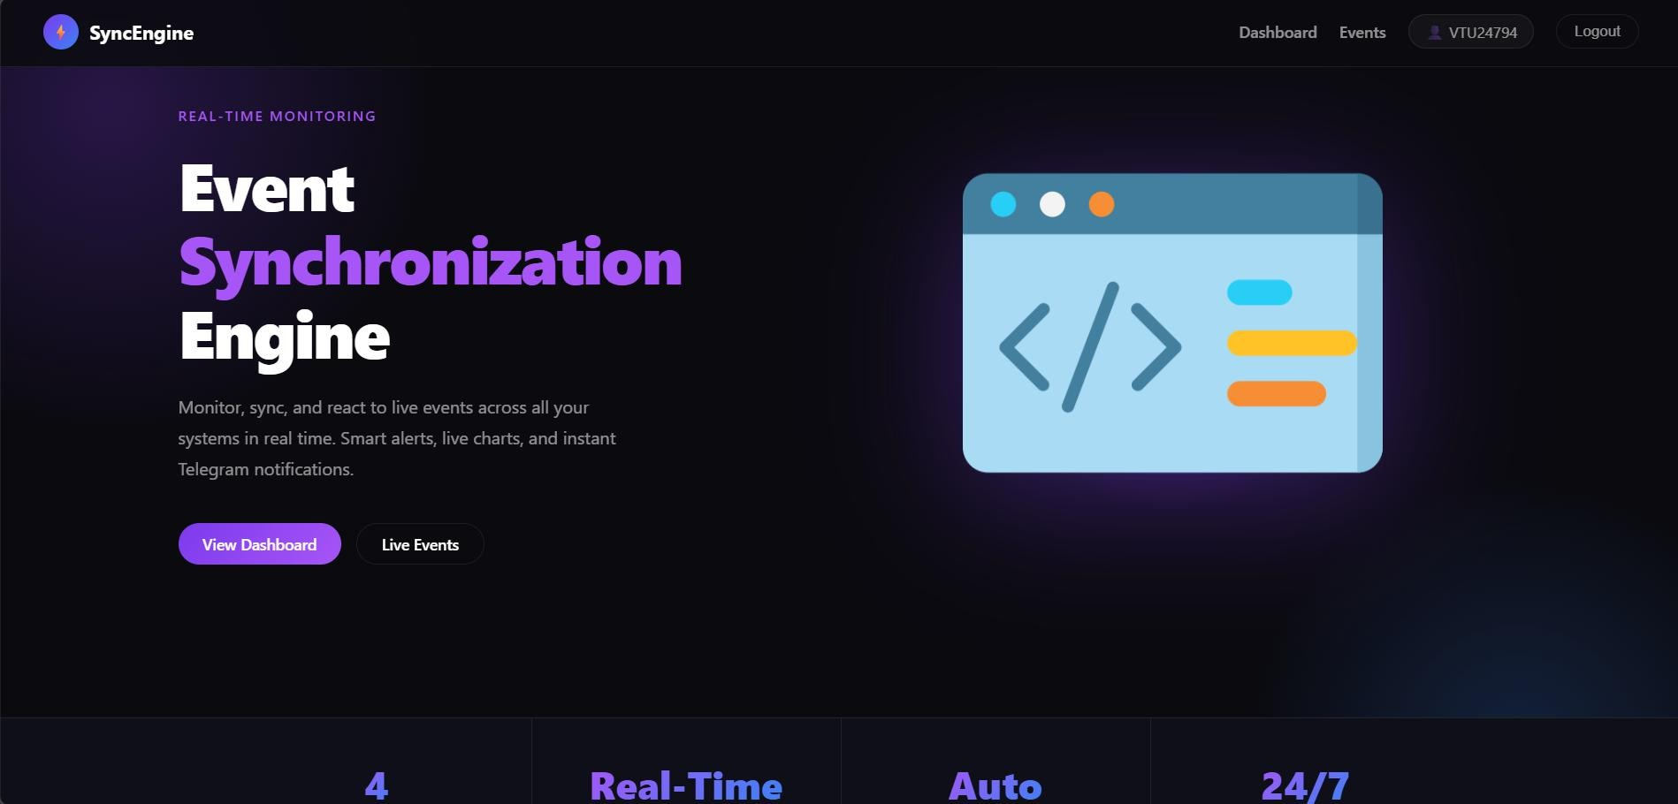
IMPLEMENTATION SCREENSHOTS
1
Home Page – Dashboard
The home page acts as the main interface of the system.
Displays all IoT system data in a centralized dashboard.
Shows statistics, charts, and system status.
Data is updated in real-time using WebSocket.
2
3
4
5
6
7
8
9

Slide 11
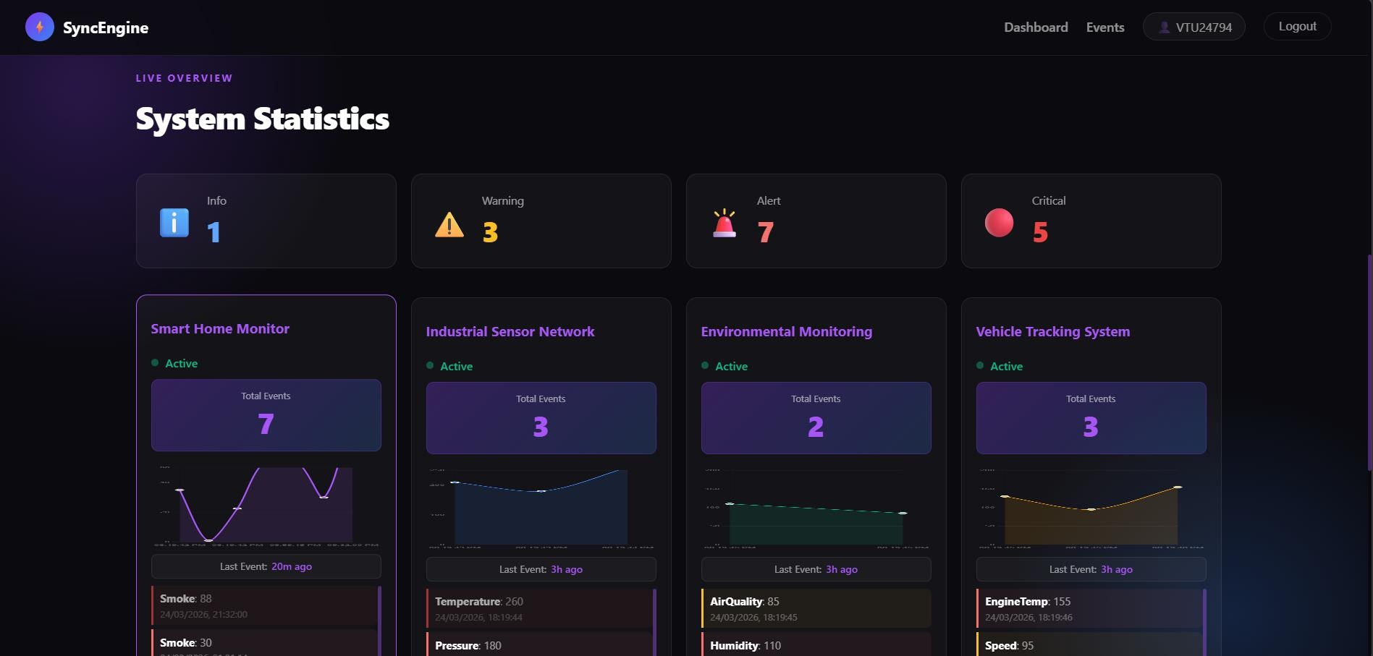
IMPLEMENTATION SCREENSHOTS
1
Dashboard / System Monitoring
Displays multiple system cards (Smart Home, Industrial, etc.).
Shows real-time event values and system status.
Updates instantly without refreshing the page.
Helps users monitor multiple systems efficiently.
2
3
4
5
6
7
8(A)
9

Slide 12
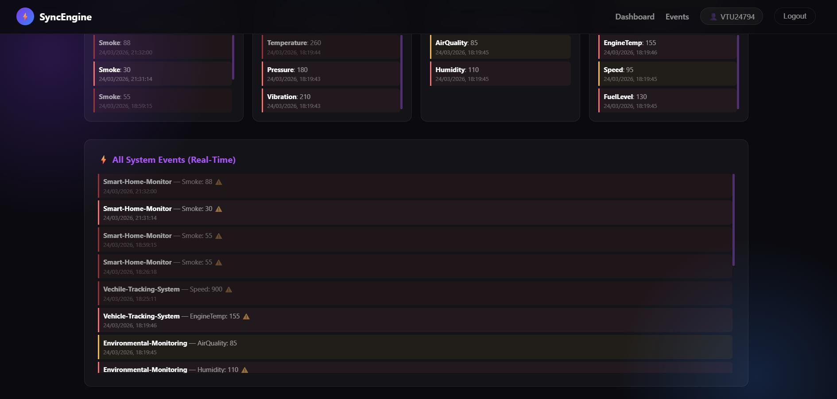
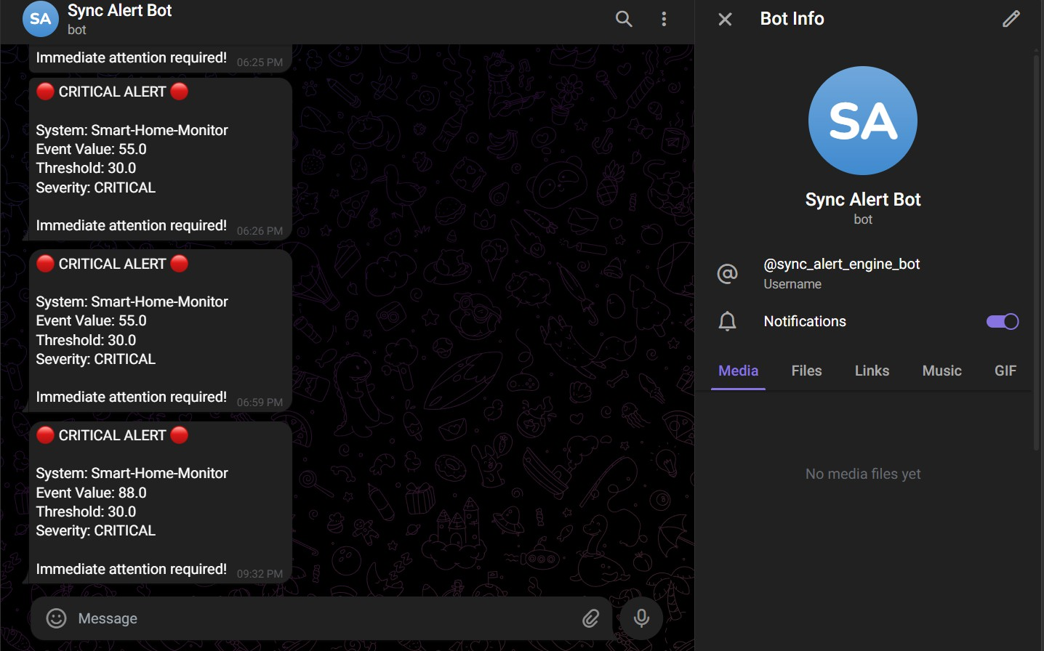
IMPLEMENTATION SCREENSHOTS
1
Event Monitoring & Alerts
Displays recent events with severity levels.
Color-coded status (INFO, WARNING, ALERT, CRITICAL).
Automatically updates when new data is received.
Telegram alerts are triggered for critical values
2
3
4
5
6
7
8(B)
9

Slide 13
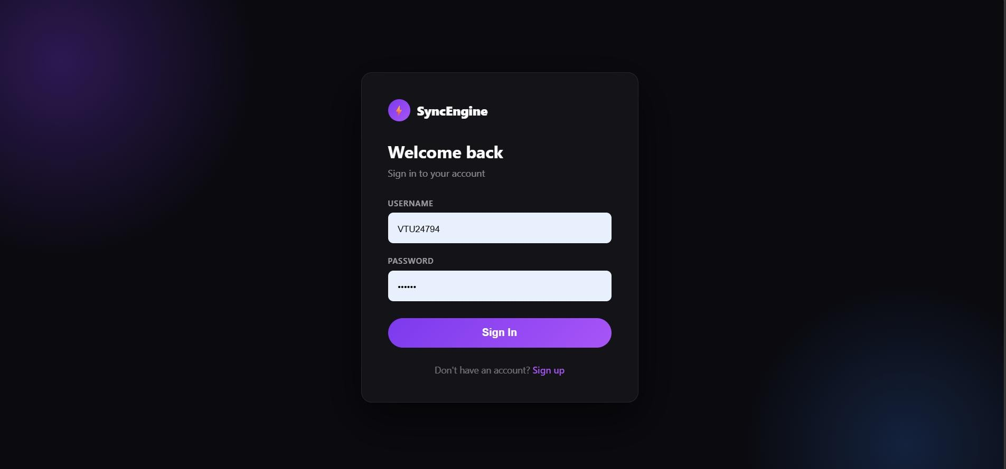
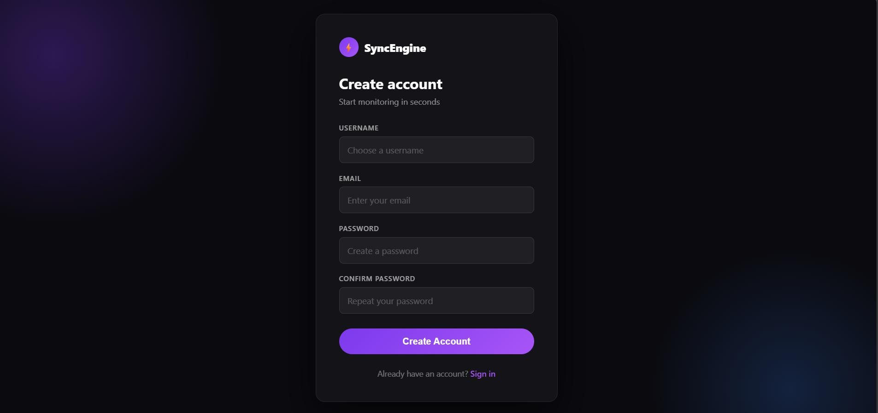
IMPLEMENTATION SCREENSHOTS
1
Signup Page
Users can create a new account by entering details such as username, email, and password.
Input data is validated to ensure correctness and avoid invalid entries.
Passwords are securely stored using encryption (hashing).
User details are saved in the MySQL database for future access.
Prevents duplicate accounts using unique email/username validation.
2
3
4
5
Login Page
Users enter their registered email/username and password to access the system.
The system verifies credentials with database records.
If credentials are correct, user is granted access to the dashboard.
If invalid, an error message is displayed to the user.
Ensures secure authentication before accessing system features.
6
7
8(C)
Security Features
Passwords are encrypted for better security.
Session management is used to maintain login state.
Unauthorized users cannot access protected pages.
Prevents unauthorized data access and improves system safety.
9

Slide 14

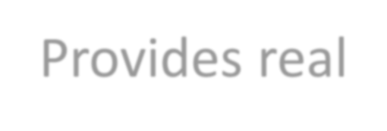


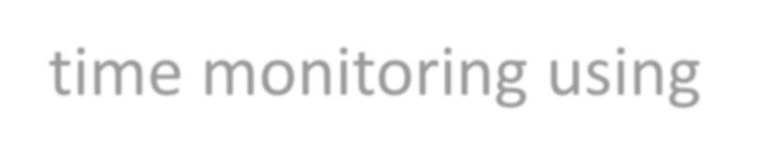
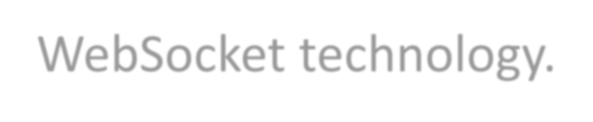

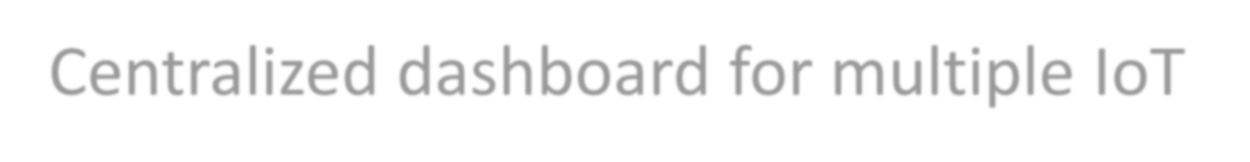
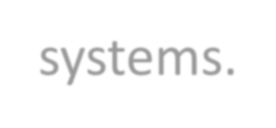
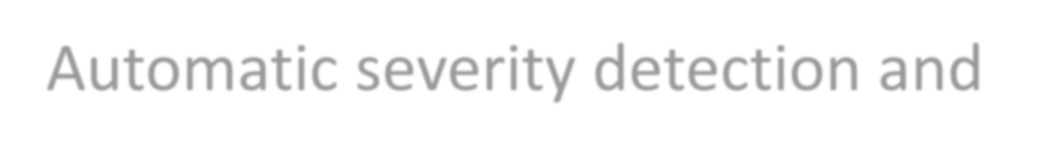
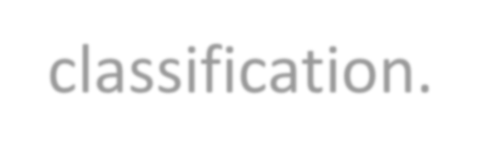
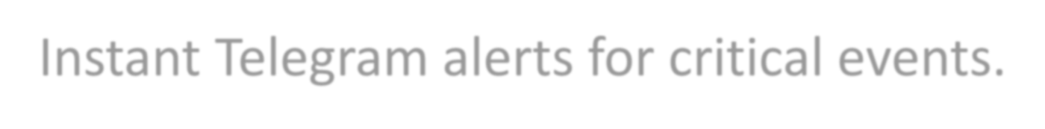
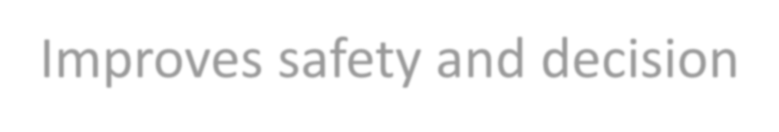
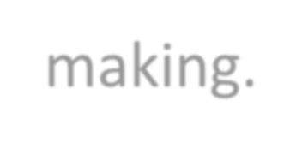
ADVANTAGES & LIMITATIONS
1
Advantages
Provides real-time monitoring using WebSocket technology.
Centralized dashboard for multiple IoT systems.
Automatic severity detection and classification.
Instant Telegram alerts for critical events.
Improves safety and decision-making.
Limitations
No authentication or security module (basic version).
Depends on internet connectivity for real-time updates.
Limited historical analytics features.
Fixed threshold values (not dynamic).
2
3
4
5
6
7
8
9

Slide 15
Thank you

